Slide 1
STEPS IN INTUBATION
ORAL INTUBATION TECHNIQUES
The act of intubation alternates hands. One hand positions the patient for the next action by the other hand. With practice, coordinating the alternating hand movements becomes natural. Once the head is optimally positioned, tilt the head into extension with your right hand to bring all the axes into alignment. This provides you with as straight a path as possible to see the larynx and pass the tube.

Slide 2
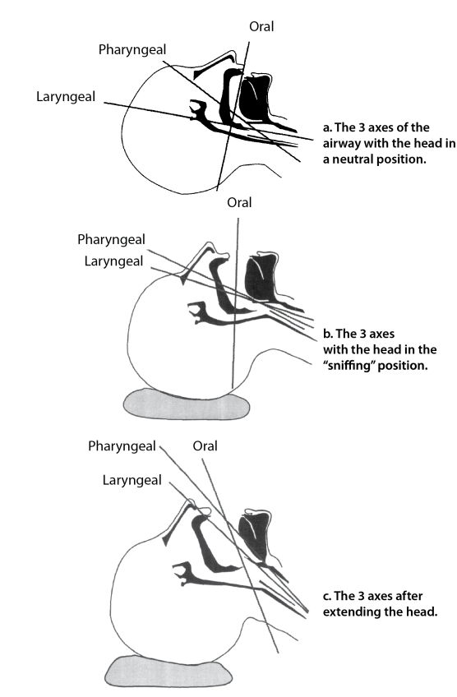
THE THREE AXES OF AIRWAYS ALIGNMENT

Slide 3
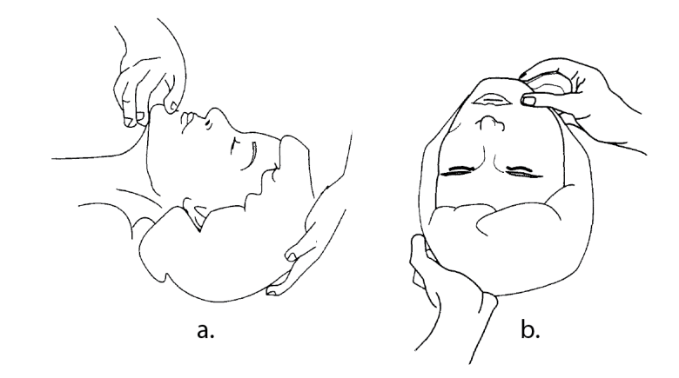
Anchor it there momentarily using your left hand
Then Tilt the head into extension and anchor it there with your left hand

Slide 4
Anchoring the head frees your right hand. Open the mouth with your right hand by placing your thumb on the lower jaw and your middle finger on the upper jaw. The position is similar to snapping your fingers. By using a pushing rather than a spreading motion, you can open the mouth wider and more forcefully. Make sure that you place your fingers as far to the right side of the mouth as you can in order to keep your fingers out of the way of the blade. Your right hand now does double duty. It holds the mouth open as wide as possible. Pulling toward you also places the head in extension.

Slide 5
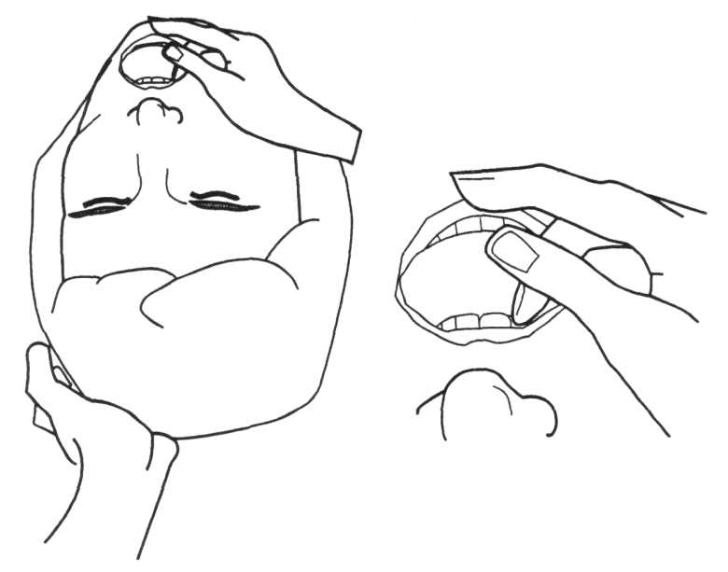
As you hold the head in extension, open the mouth with your right hand. Keep your fingers to the far right of the mouth to leave plenty of room

Slide 6
You can now use your left hand to pick up the blade. Hold it with the blade away from you. Because my hands are small, I place my hand lower down on the handle. By positioning the heel of my hand on the junction between blade and handle, I can fine tune the angle of the blade. You will need to see what feels correct for you.Notice how easily you can change the angle of the blade by tilting your wrist. You must control this motion carefully to avoid tooth damage.

Slide 7
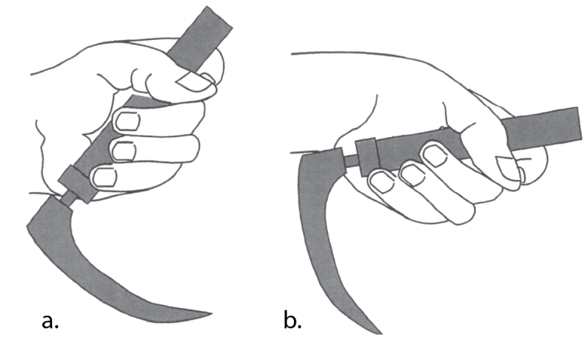
Hold the handle in your left hand with the blade away from you.

Slide 8
INSERTING THE BLADE; PROTECTS THE LIPS AND TEETH
Insertion of the blade should be delicate and deliberate. Hold the handle in your left hand, blade down, pointing away from you. Grasp it firmly but don’t clench your fist because this decreases control and causes early fatigue.
With the mouth open, insert the blade, slightly to the right of the tongue. Don’t hit the teeth as you insert. If necessary, you can tilt the top of the handle slightly to insert the blade into the mouth, then rotate the blade back, scooping it around the right side of the tongue as you do so.
Avoid catching the lips between the blade and the teeth. I use my right index finger to sweep the lips out of the way of the blade as I insert it. You may need to angle a curved blade slightly to pass the teeth and then return the blade to a more neutral position once it has entered the mouth.

Slide 9
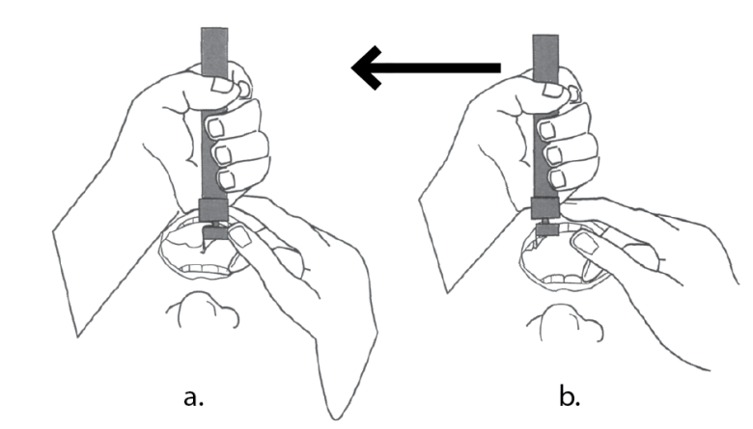
Look For The Tip Of The Epiglottis Before The Final Lift
Slowly advance the blade with your left hand until you see the tip of the epiglottis, a very important landmark. Simultaneously sweep the tongue to the left as you advance . Once you see the epiglottis you can start to transfer the weight of the patient’s head onto the blade as you lift. Leave your blade toward the left side of the mouth with the tongue pushed out of the way.
Insert the blade to the right side of the tongue and sweep the tongue toward the left. Look for the tip of the epiglottis and make some final adjustments before beginning your lift.

Slide 10
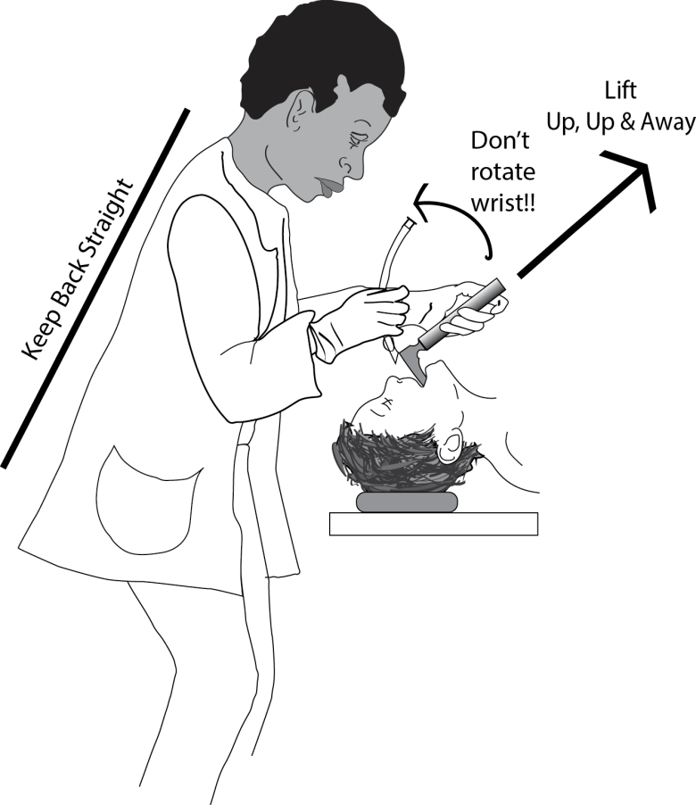
How You Lift Matters
Good intubation technique depends on optimal mechanical advantage. Lift upward with the left arm held fairly rigid. Keep you elbows in. Lift on a line connecting the patient’s head with the intersection of the opposite ceiling and the wall . It won’t be straight, but keeping your arm straighter and fairly rigid it gives you the strength of your shoulders to lift the head. It prevents you from using the teeth as a fulcrum — dangerous for the teeth. And it allows you to use binocular vision for depth perception.
Optimal posture during intubation allows you full control of your arms, wrists and hands to control the blade.

Slide 11
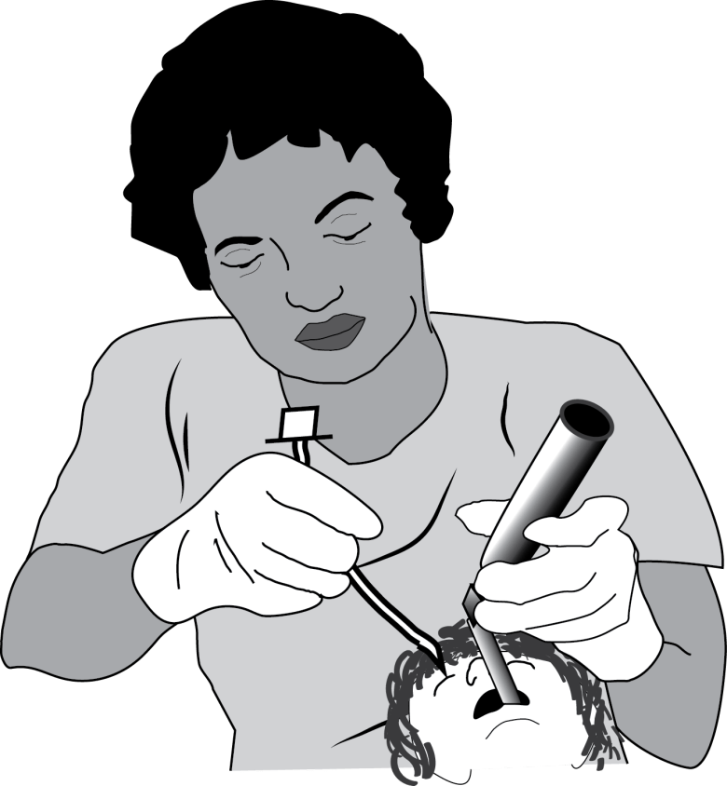
With your shoulders relaxed and your arms by your sides you can lifting the jaw easily without rotating the blade back onto the teeth.

Slide 12
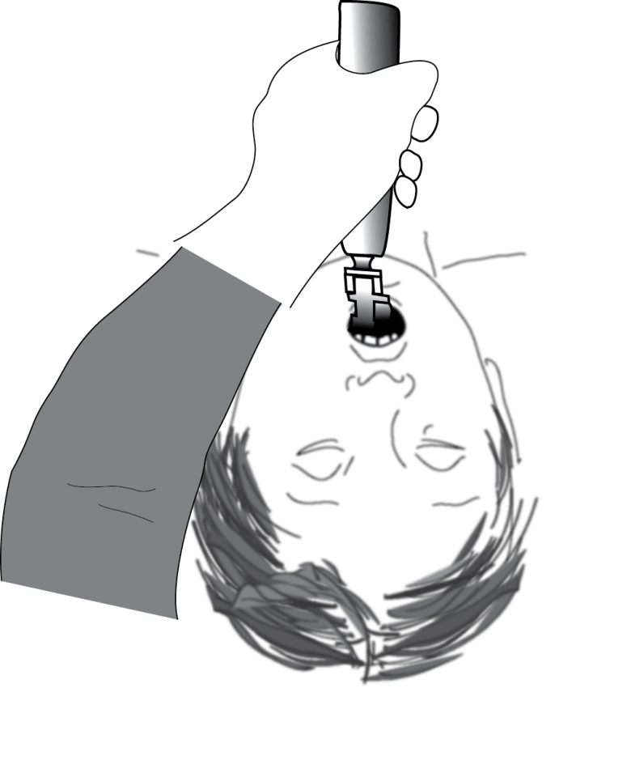
During laryngoscopy lift upward and away, never rotate the blade back onto the teeth.

Slide 13
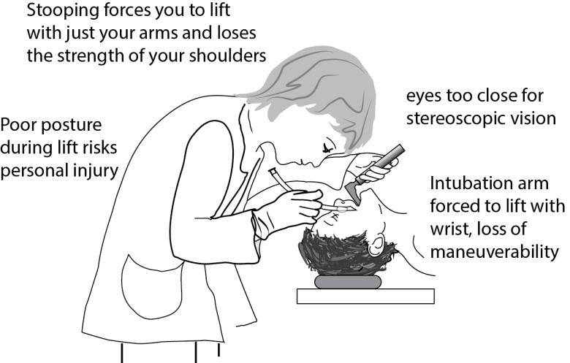

Slide 14
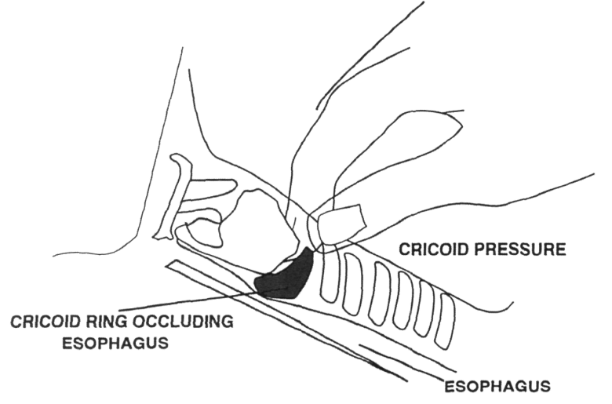
To apply cricoid pressure your helper presses the cricoid ring firmly down against the esophagus, bringing the larynx into view.

